Slide 1

LoL-V2T: Large-Scale Esports Video Description Dataset
CVPRW (2021)

Slide 2
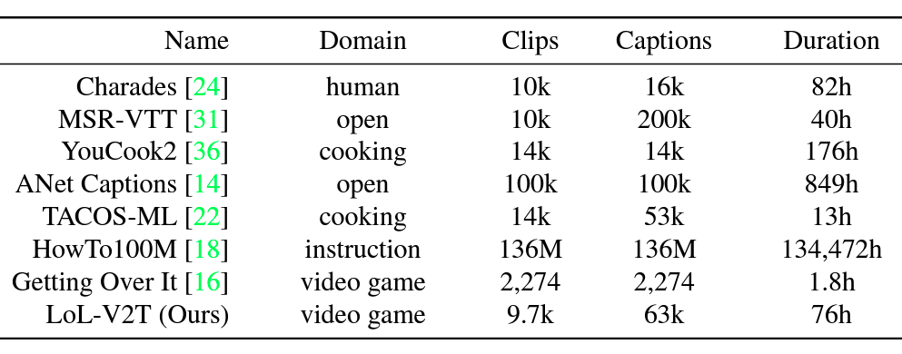
LoL-V2T: Large-Scale Esports Video Description Dataset [Link]
Background - Electronic sports data-to-text generation (eSports)
Addressed problems
eSports Background
Esports are growing rapidly in popularity, in 2019 with a year-on-year growth of +22.7% and is approaching the scale of existing sports leagues
The main content in esports consists of tournament or gameplay videos
New audience may have difficulties to understand the game content
Captions are a useful tool for viewers to understand the status of a match
Video Description Dataset
VideoDescription
Early work in video description was based on template-based methods
With the growth of deep learning,a method using an encoder-decoder framework for video description was proposed (CNN + RNN)
Transformer architecture to the Video Description Model
Video Description in Video Game
Generate captions using Structured SVM and LSTM for tennis video game
NBA games as inputs and generated captions using LSTM
Generated a caption for each frame by training a simple CNN model that combines three conv layers with 75 minutes of Minecraft “Let’s Play” videos
Apply sequence-to-sequence networks with attention to this task
Captions contain a significant amount of proper nouns specific to the esports title and numerals that describe the status of matches.
Some important objects in the clips are difficult for captioning models to recognize because their size and subtle motions
Some pairs of a clip and captions are not necessarily aligned temporally during captioning.
Research Aim
Proposed a large-scale dataset for esports video description, focusing on the popular game “League of Legends”
Largest video description dataset in the video game domain, and includes 9,723 clips with 62,677 captions
Presents multiple new video captioning challenges
large amounts of domain-specific vocabulary
subtle motions with large importance
a temporal gap between most captions and the events that occurred
Contribution
Build a large-scale dataset for esports video description
By tackling the difficulty corresponding to the large amounts of proper nouns and numerals
Introduce a method for video description in esports
Generate multi-sentences for esports videos, and use video paragraph captioning models that build upon the models of Vanilla Transformer and MART

Slide 3
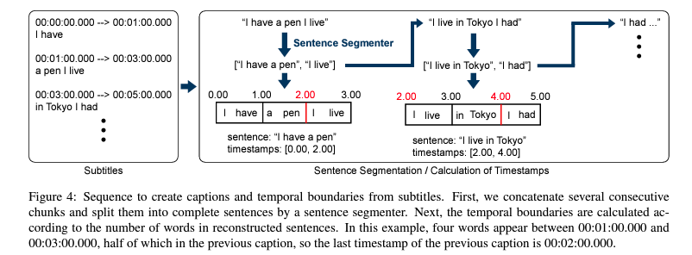
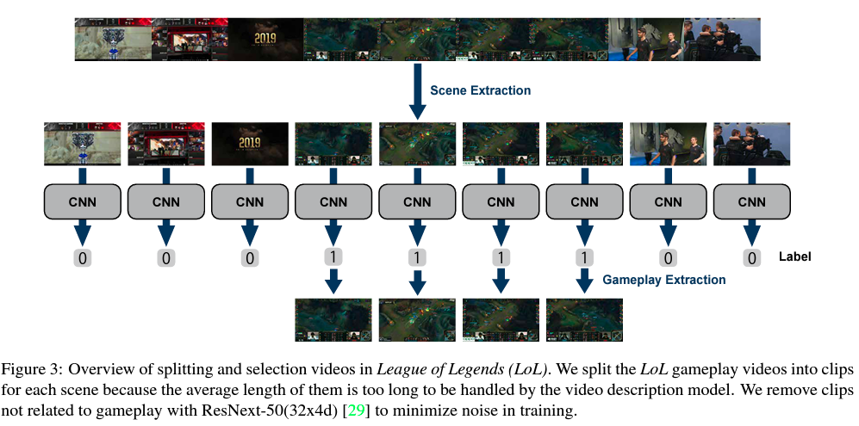
LoL-V2T: Large-Scale Esports Video Description Dataset [Link]
Methodology (Dataset)
Generation of Captions and Temporal Boundaries
Produce full-text captions and temporal boundaries from the subtitles generated from narrations by YouTube
Re-segment the chunks into complete sentences with DeepSegment
Compute the new temporal boundaries to which the reconstructed sentences correspond using the number of words in the sentences
Dataset Analysis
4,568 minutes of video and 62,677 captions
The number of clips is 9,723, average length of clips is 28.0 seconds
Average length of intervals between temporal boundaries is 4.38 seconds
Multiple captions are associated with a single clip
Data Collection
LoL-V2T consists of 9.7k clips of League of Legends playing video taken from YouTube and 63,000 captions, each video is associated with multiple captions based on manual or ASR-generated subtitles
Collect footages of 157 matches of the League of Legends world championships “Worlds” from YouTube.
Worlds has a large number of matches and commentators always provide commentary in them, it is easy to obtain narrations for the videos
The quality of narrations in esports tournament footages is higher than that of “Let’s Play” videos
Splitting Videos and Selecting Clips
The average length of collected League of Legends videos is 44 minutes, which is too long to generate captions
Split videos into clips by scene, and then remove the clips which are not gameplay
Use PySceneDetect to split the video into clips of a length that the video description model can handle, average 23.4 seconds

Slide 4
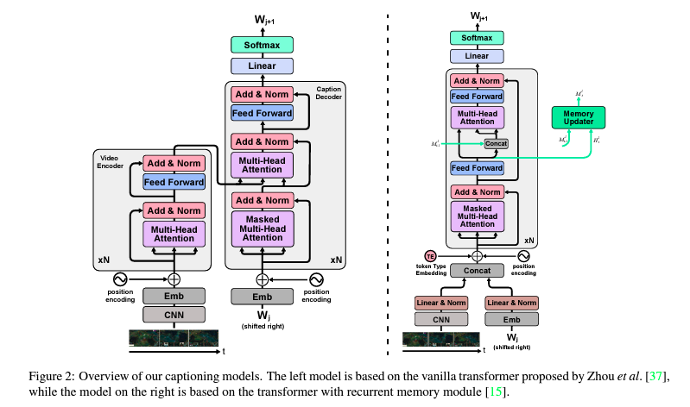
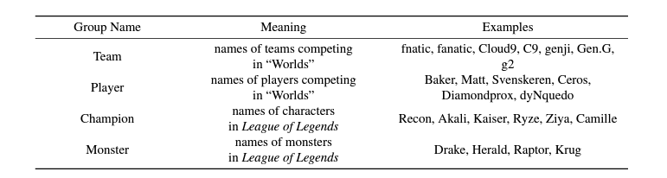
LoL-V2T: Large-Scale Esports Video Description Dataset [Link]
Methodology (Methods)
Since the masking increases the frequency of proper nouns and numerals,it makes them easier to recognize by the model
Complex proper nouns with detailed meanings are replaced by simpler proper nouns,resulting in more comprehensible captions
Vanilla Transformer
An application of the transformer to the video description task
Two components: a video encoder and a caption decoder
The video encoder is composed of a stack of two identical layers and each layer has a self-attention layer
The caption decoder inserts a multi-head attention layer over the output of the video encoder stack
Create masks with ground-truth temporal boundaries and apply them to the outputs of the video encoder to make the caption decoder focus on the event proposals in the clips
MART
Amodel based on the transformer for the video paragraph captioning task
The transformer model decodes each caption individually without using the context of the previously generated captions
A unified encoder decoder design, where the encoder and decoder are shared
An external memory module similar to LSTM and GRU that enables the modeling of history information of clips and generate dcaptions
Masking
Although proper nouns and numerals are important for explaining game play, they are difficult for captioning models to learn. Masking can address this problem.
Classify the proper nouns in the captions into groups by meaning
When a proper noun or numeral appears in acaption, we mask it with the name of the group to which it belonged

Slide 5
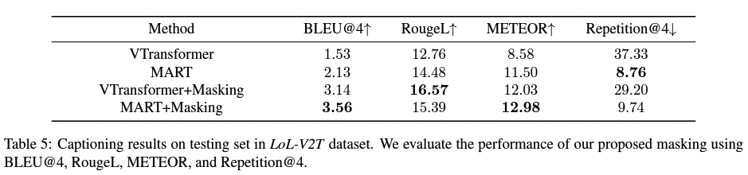
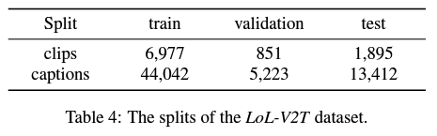
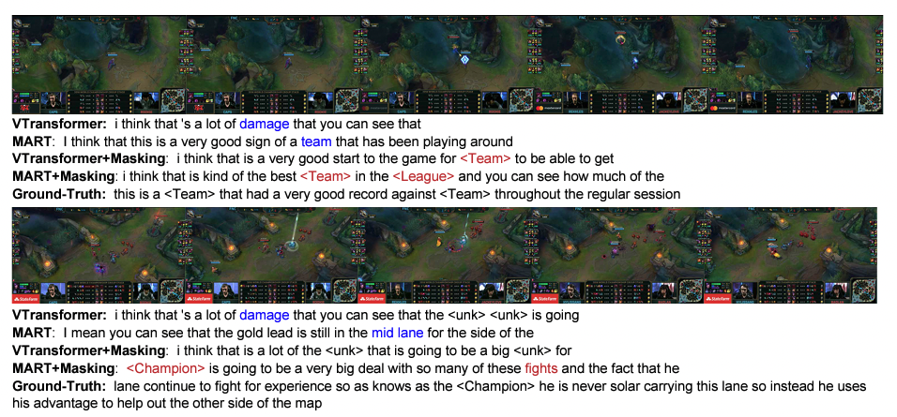
LoL-V2T: Large-Scale Esports Video Description Dataset [Link]
Experiments and results
Results and Analysis
Proposed masking outperforms the baseline in BLEU@4, RougeL, and METEOR
MART outperforms Vanilla Transformer in Repetition@4
Implementation Details
Down-sample each video every 0.26s and extract the TSN features from these sampled frames
TSN implementation was built upon the mmaction2
Two different ResNet-50 model pre-trained on Kinetics-400 without fine-tuning
All captions are converted to lowercase.
The words that occur less than 5 times in all captions are replaced with “<unk>” tags
Evaluation Metrics
Measure the performance on the video description task with four automatic evaluation metrics
BLEU
RougeL
METEOR
Repetition
Use the standard evaluation implementation from the MSCOCOserver

